Slide 1
2016311821 한승하

Slide 2
Topic 2. Library System
Functionality (1 point per each, maximum 5 points)
1) Sign up, Sign in, Sign out
2) [MUST] Search books by keyword and then show the book information
Book title, writers, book ID, book status(Available/Not Available), book location
3) Reserve the books
If the status is available, then the customer can reserve the book
Otherwise, the customer will be on the waiting lists.
4) [PLUS] Reserve the study rooms
Show the available time, space
Only if the study room is available, then the customer can reserve the space
5) My page
Show the personal information (student ID, ..)
Show the borrowed book, books on hold, overdue book, overdue fines

Slide 3
date
bid
title
author
id
password
name
M
rent
N
available
lid
Register
Book
M
N
location
M
N
waiting
time
reserve
Witten by
priority
date
N
1
Study room
Publisher
pid
p_name
Rid
R_name

Slide 4
Studyroom
waiting
rid
name
lid
bid
priority
Reserve
lid
rid
date
time
Register
lid
id
password
name
Rent
lid
bid
date
Book
bid
pid
title
author
availalbe
location
Publisher
pid
p_name

Slide 5
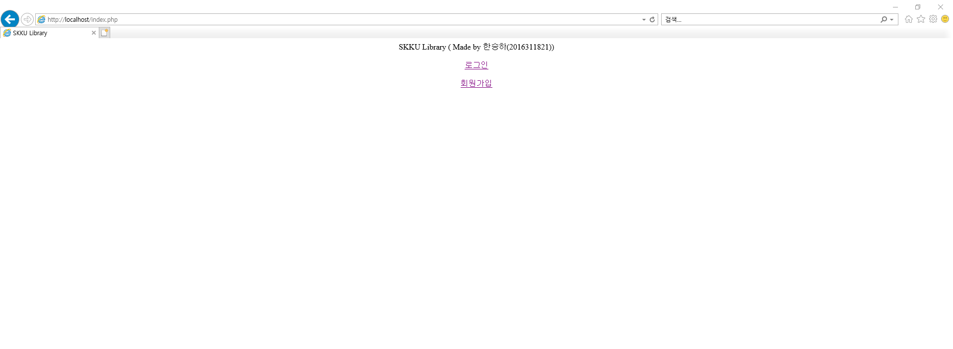
SIGN UP, LOGIN, LOG OUT

Slide 6
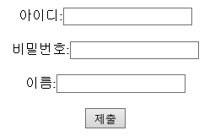
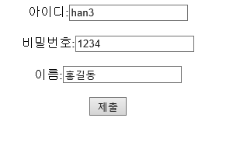



SIGN UP, LOGIN, LOG OUT
ERROR CASES

Slide 7
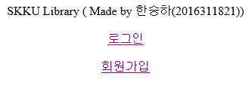
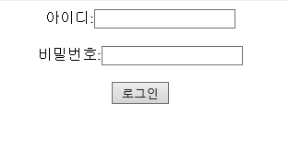
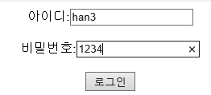


SIGN UP, LOGIN, LOG OUT
ERROR CASES

Slide 8
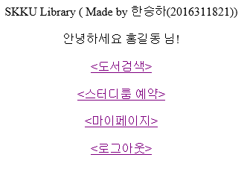
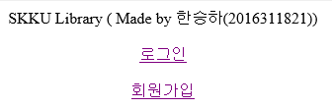
SIGN UP, LOGIN, LOG OUT

Slide 9
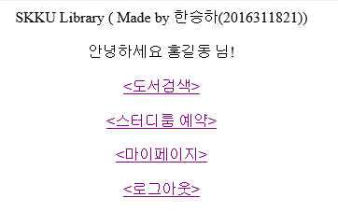
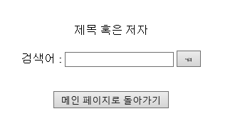
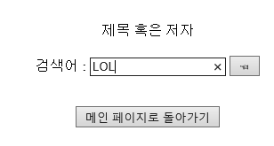
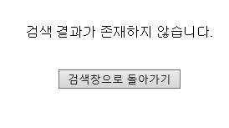
Search books
IF No Books

Slide 10
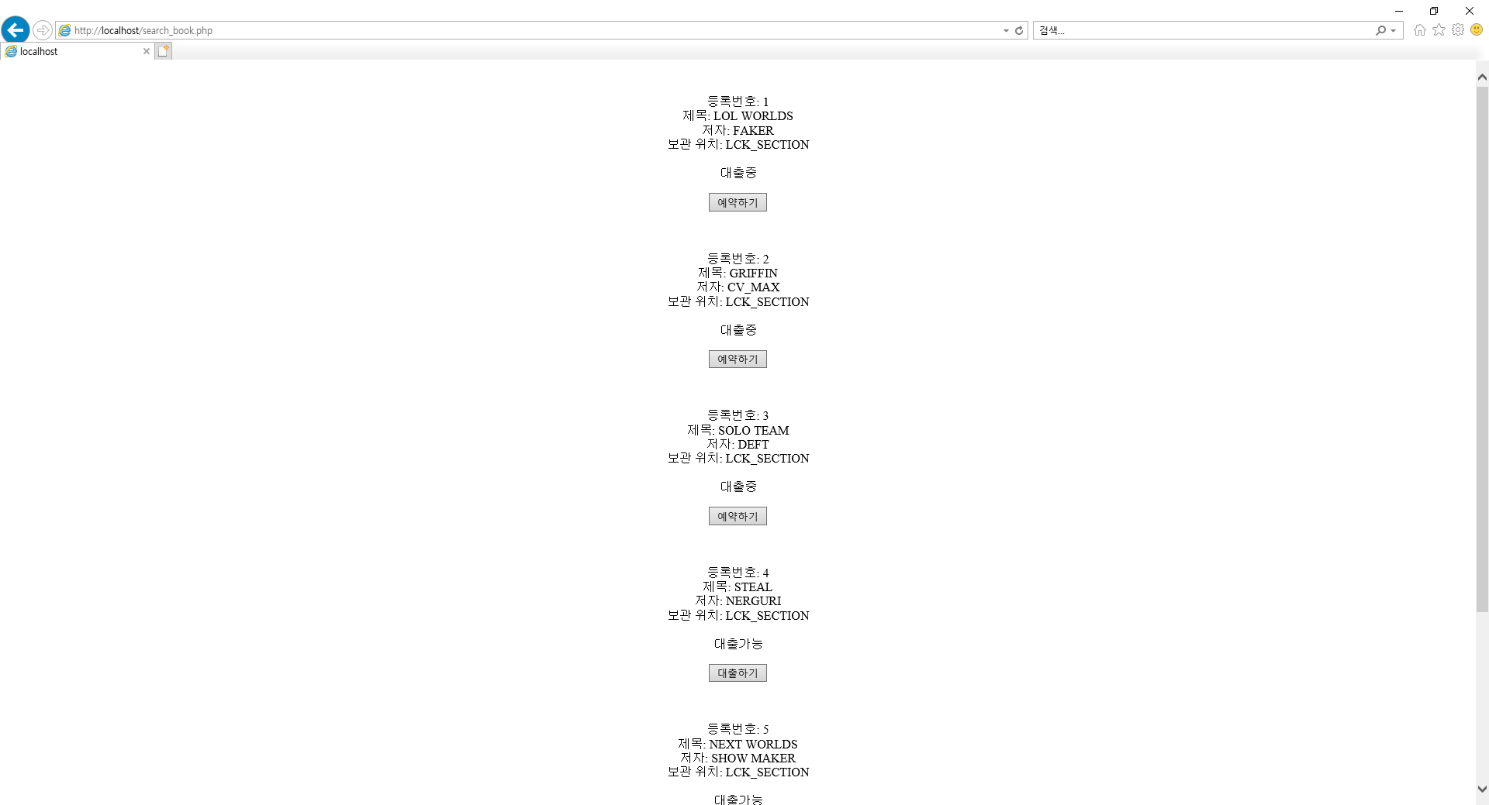
Search books

Slide 11
Reserve books
(1)
(2)

Slide 12
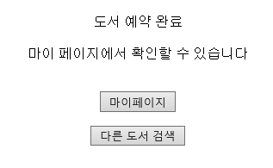
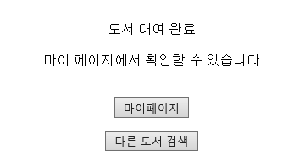
Reserve books
(1)
(2)

Slide 13
Reserve the study rooms

Slide 14
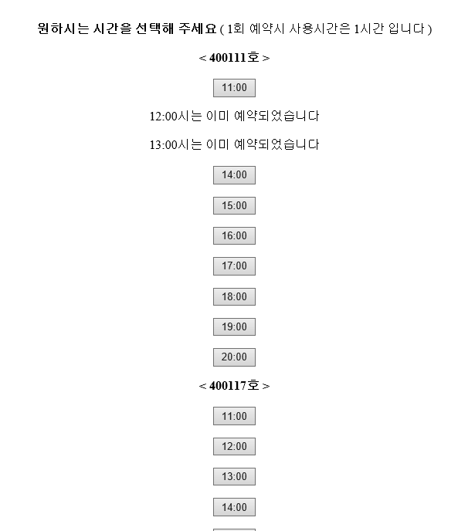
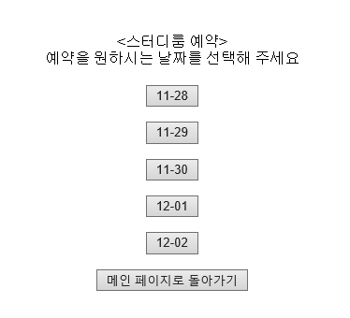
Reserve the study rooms

Slide 15
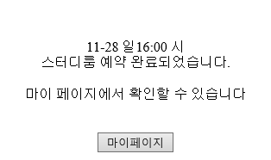
Reserve the study rooms

Slide 16
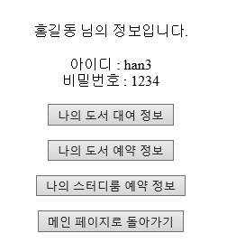
My page

Slide 17
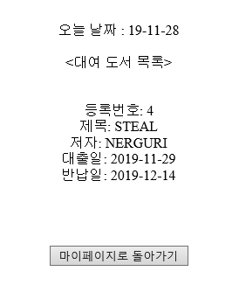
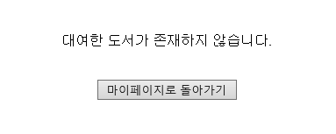
No rent

Slide 18
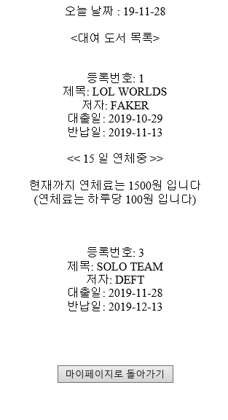
My page

Slide 19
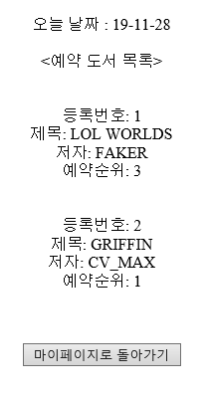
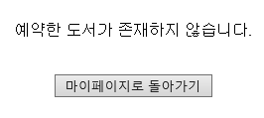
My page
No waiting

Slide 20
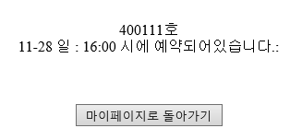
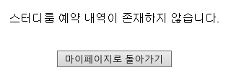
My page
No Reservation

Slide 21

감사합니다

